Slide 1

Analytical CRM Development Of Bank.
Power Point Presentation
By Dhanshree Soni

Slide 2
Objective
The main objective is leveraging customer data to develop analytical insights that can help the bank reduce customer churn, improve service delivery, and enhance customer satisfaction.
Analyze Customer Churn: Identify factors contributing to customer churn (why customers leave the bank) by segmenting customers based on demographics, account details, and activity levels.
Predict Churn Risk: Develop insights to predict which customers are at higher risk of churning, allowing the bank to take proactive steps to retain them.
Improve Service Delivery: Analyze customer behavior and preferences to identify areas where the bank can improve service delivery and product offerings.

Slide 3
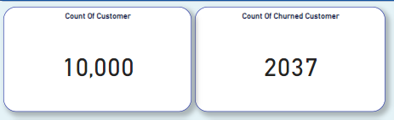
Total Number Of Customer & Churn Count

Slide 4
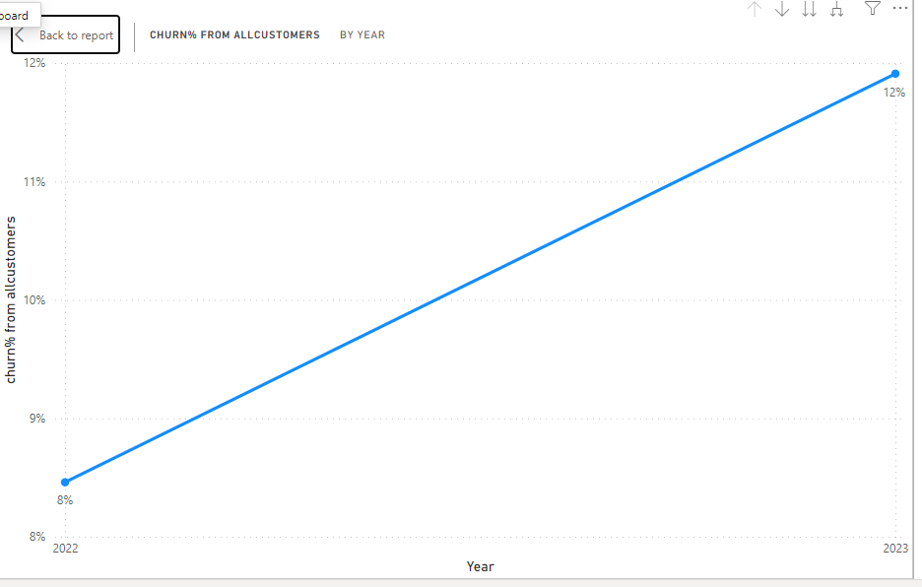
Customer Churn Rate w.r.t Year
Churn Percentage increased from the year 2022 to 2023

Slide 5
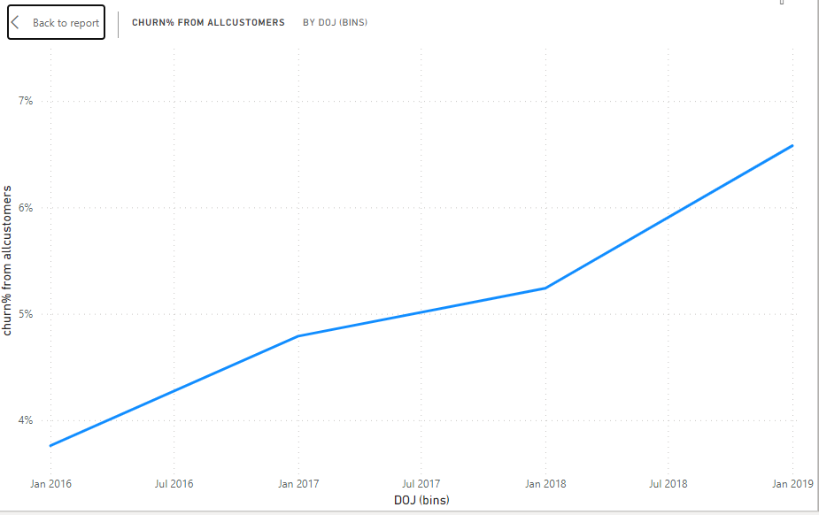
Customer Churn Rate w.r.t DOJ
There is a gradual increase in the Churn Percentage for the customers who joined at latest years.

Slide 6
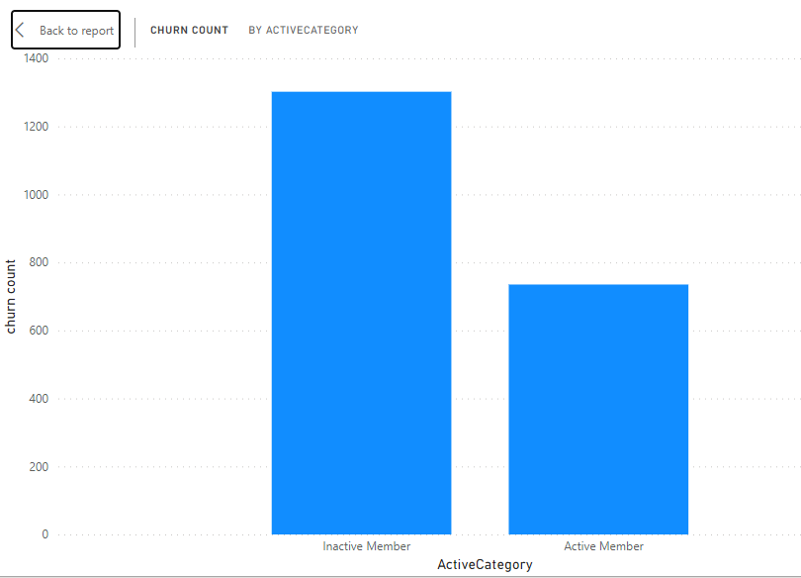
Customer Churn Count w.r.t Customer Active Status
Customers who are inactive has higher count of getting churned.

Slide 7
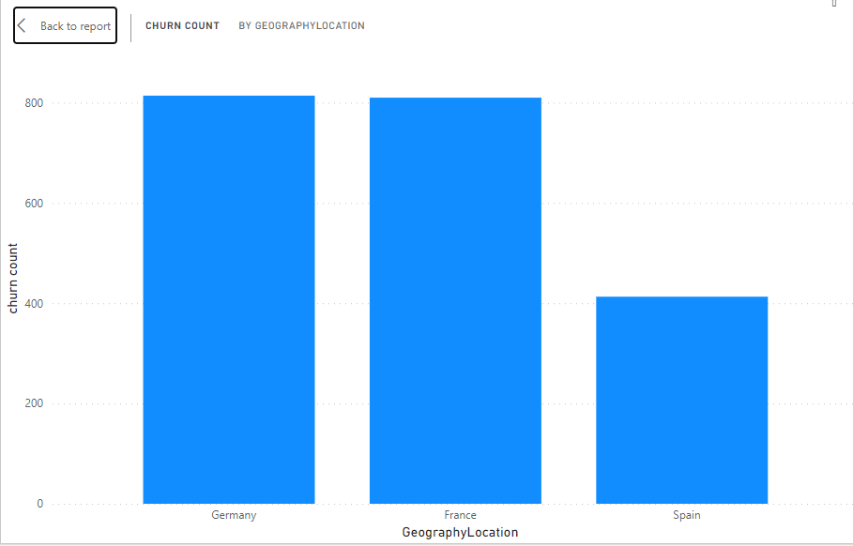
Customer Churn Count w.r.t Geography Location
Customers who are from the location Germany and France have higher count of getting churned.

Slide 8
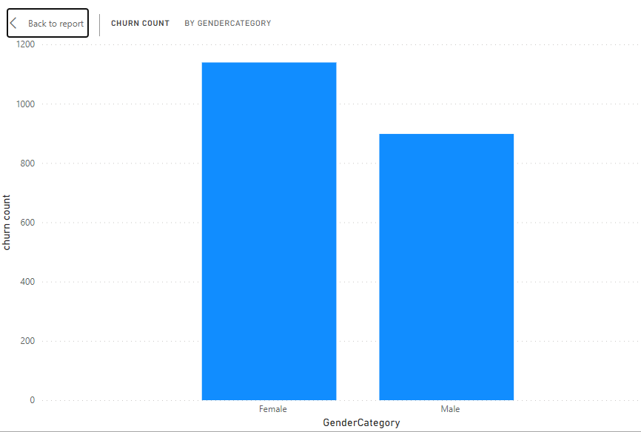
Customer Churn Count w.r.t Gender
Female Customers have higher count of getting churned.

Slide 9
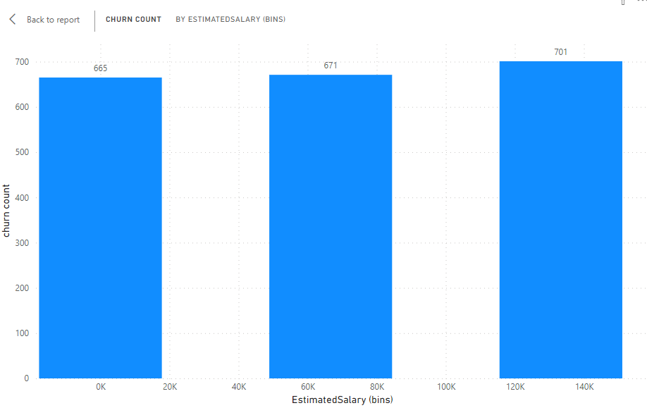
Customer Churn Count w.r.t Estimated Salary
There is not large difference between the salary and churn count. According to the graph higher the salary, higher is the churn percentage.

Slide 10
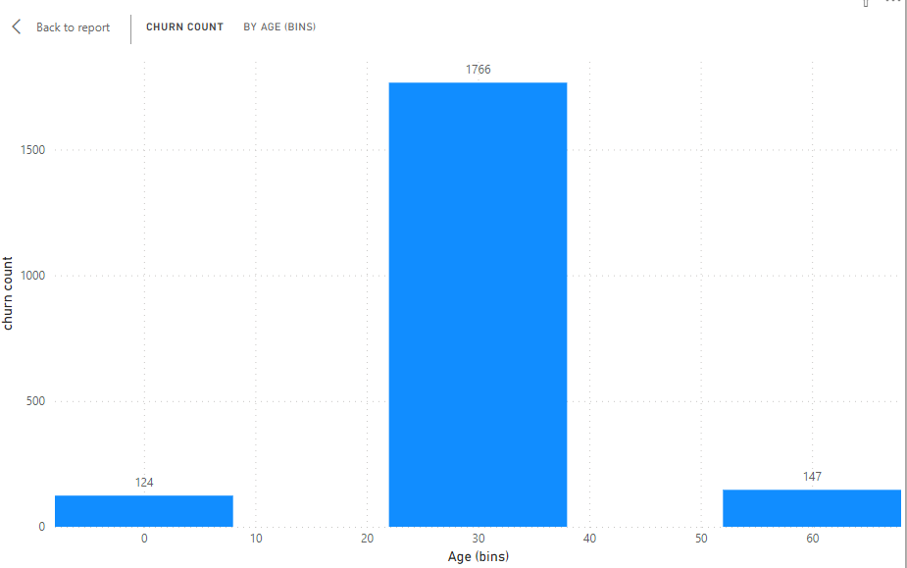
Customer Churn Count w.r.t Customer Age
Customers who are in between the age of 20 to 40 have higher churn percentage.

Slide 11
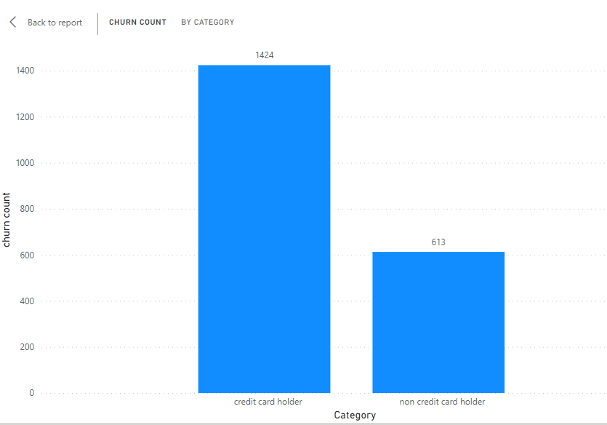
Customer Churn Count w.r.t Credit Card
Customers who have credit cards have higher churn percentage.

Slide 12
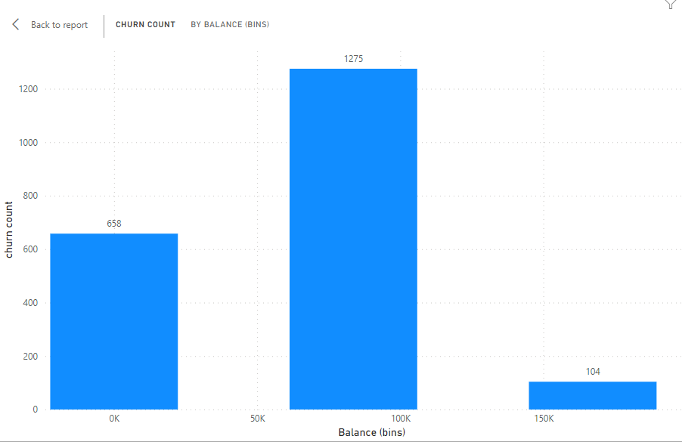
Customer Churn Count w.r.t Bank Balance
Customers who has average bank balance between 50K to 100k have higher churn percentage.

Slide 13
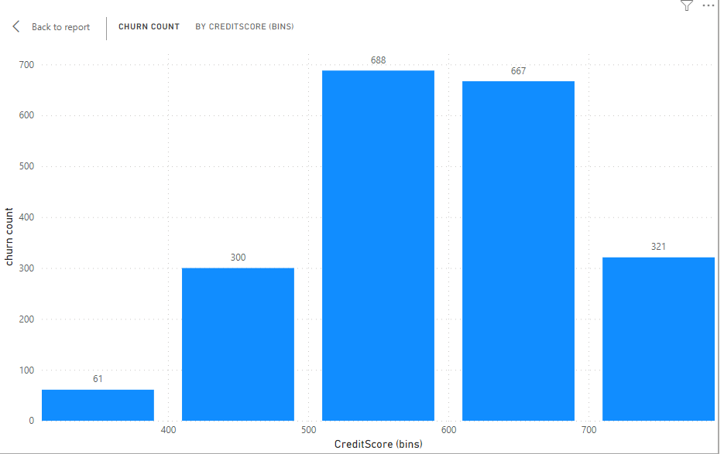
Customer Churn Count w.r.t Credit Score
Customers who has average credit scores between 500 to 700 have higher churn percentage.

Slide 14
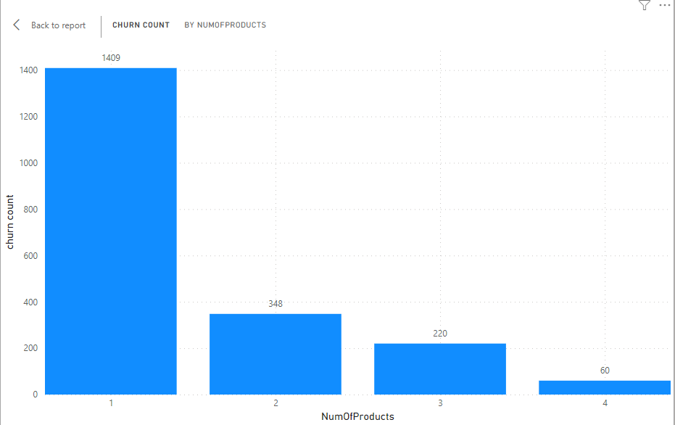
Customer Churn Count w.r.t No. Of Products
Customers who has purchased lesser number of products, specifically 1 have higher churn percentage.

Slide 15
Briefing All The Segments Affecting Churn Count
Customers who are from Germany and France
Customers who are inactive
Customers who have credit cards
Customer who has a smaller number of products, particularly 1
Customers who are female
Customers who has average credit score and bank balance
Customers whose joining year was 2018 or 2019
Tends to have higher churn count

Slide 16
Measures To Reduce Churn Count
Targeted Marketing and Cross-Selling:
Develop targeted marketing campaigns: Focus on these customer segments in Germany and France. Highlight the benefits of using multiple products (e.g., bundled packages with discounts).
Cross-selling opportunities: Recommend additional products or services that complement their existing accounts (e.g., savings accounts for those with average balances, credit cards with rewards programs for inactive customers).

Slide 17
Measures To Reduce Churn Count
Engagement Strategies:
Welcome packages and onboarding: For new customers, provide a personalized onboarding experience to educate them about available products and services.
Reactivation campaigns: Target inactive customers with special offers or incentives to re-engage them, such as temporary fee waivers or personalized financial advice.
Improved Customer Service:
Proactive outreach: Contact new and inactive customers proactively to address any concerns or questions they might have.
Digital tools and resources: Develop user-friendly online banking platforms and mobile apps to improve accessibility and convenience for customers who prefer digital interactions.

Slide 18
Measures To Reduce Churn Count
Personalization:
Personalized communication: Use customer data to personalize communication and offers, making them more relevant and engaging.
Additional Considerations:
Analyze reasons for inactivity: Understand why these customers are inactive. It could be due to lack of product knowledge, dissatisfaction with existing products, or life changes. Address these specific reasons in your strategies.

